Slide 1

How Sentimental Tweets Influence Bitcoin Prices
Wenxuan Song, Shiqi Lin, Wei-Bo Kao, Lin Xiao
08.04.2024

Slide 2
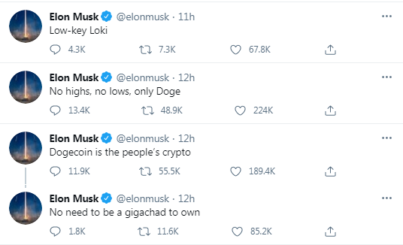
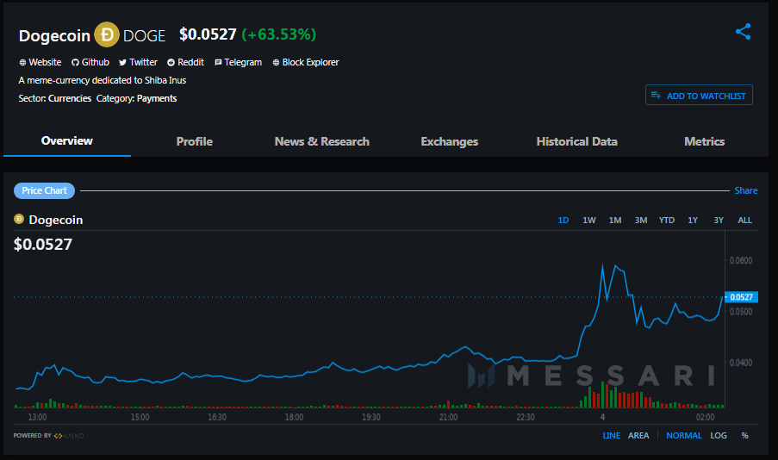
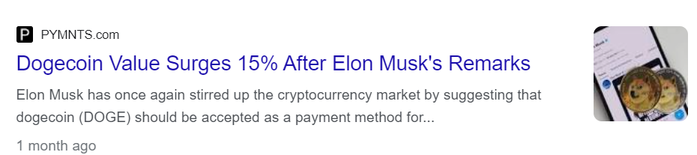
Notes:
Whenever Elon Musk posts encouraging tweets about Doge coin, Doge experiences a surge in price.
How ever does the general sentiment of the public expressed on social media have a measurable effect on cryptocurrencies?

Slide 3
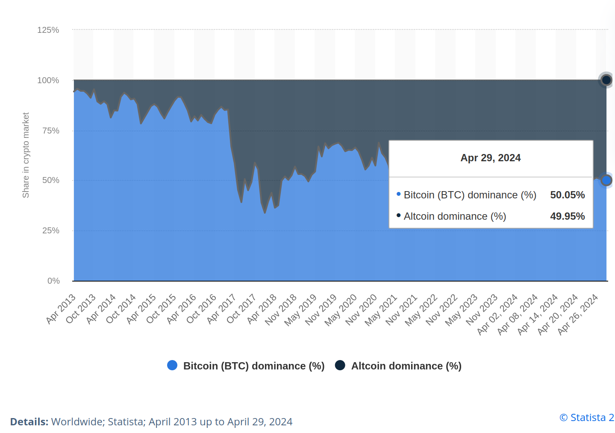
Motivation: Bitcoin
Market Dominance:
-> largest cryptocurrency by trading volume and market cap
-> ripple effects on other digital assets.
Mainstream Recognition:
-> often covered in mainstream media.
Volatility and Speculation:
-> attract a significant amount of attention and discussion
on social media platforms.
Bitcoin market dominance — market cap relative to market cap of all other cryptocurrencies — from April 2013 up to April 29, 2024
Notes:
Bitcoin has consistently maintained the highest market capitalization and trading volume among all cryptocurrencies. Its dominance in the cryptocurrency market means that changes in Bitcoin's price and sentiment often have ripple effects on other digital assets.
It has achieved widespread recognition and adoption beyond the cryptocurrency community. It's often covered in mainstream media, discussed by financial analysts, and considered by institutional investors.
The high price volatility and speculative nature of bitcoin attract a significant amount of attention and discussions from traders, investors, and enthusiasts on social media platforms.

Slide 4
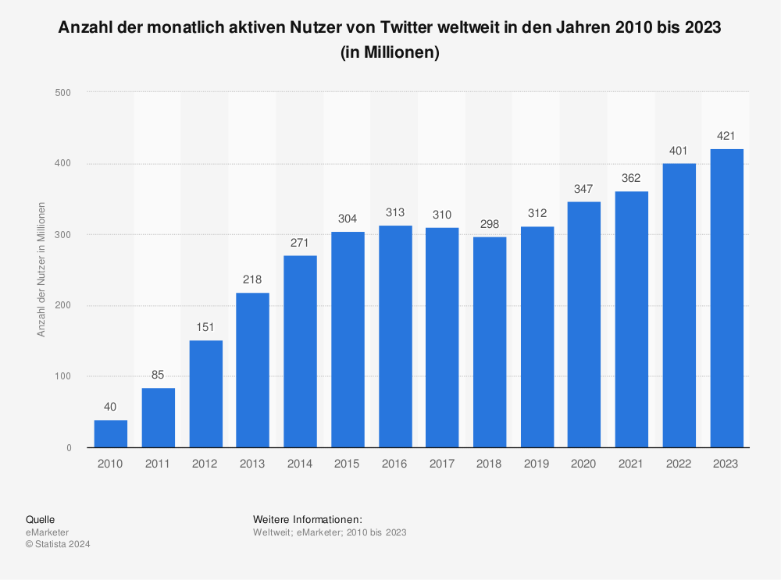
Motivation: Twitter/X
Large User Base:
-> around 421 millions of monthly active users worldwide
-> provides a diverse range of opinions and sentiments
Real-Time Updates:
-> users posting updates, opinions, and reactions to events as they happen.
-> particularly useful for tracking sentiment changes related to breaking news or market events.
Influencer Presence:
-> Many influential figures are active on Twitter which can influence market sentiment and investor behavior
number of monthly active users of twitter worldwide from 2010 till 2023 (in millions)
Notes:
Large User Base: Twitter has a large user base, with 421 millions of active users worldwide. This vast user base provides a diverse range of opinions and sentiments regarding Bitcoin, making it a rich source of data for sentiment analysis.
It is known for its real-time nature, with users posting updates, opinions, and reactions to events as they happen. This immediacy makes Twitter data particularly useful for tracking sentiment changes related to breaking news, market events.
Many influential figures in the cryptocurrency space, including industry leaders, analysts, traders, and media personalities, are active on Twitter. Their tweets and discussions can significantly influence market sentiment and investor behavior.

Slide 5
How does sentimental tweets influence the price of Bitcoin?

Slide 6
Hypothesis
The sentiments of tweets containing #Bitcoin or #BTC is positively correlated with the short-term and long-term price movements of Bitcoin.
The sentiments can be used to predict Bitcoin price.

Slide 7
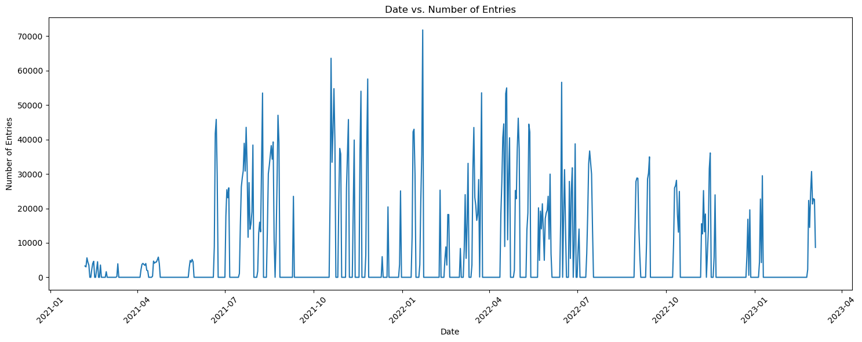
Dataset Characteristics
Bitcoin tweets
Collected from Twitter API and contains all tweets with #Bitcoin or #btc - Size: 4’859’004 rows x 13 columns - Timespan: 06. Feb 2021 till 05. Mar 2023 - Columnnames: [user_name, user_location, user_description, user_created, user_followers, user_friends, user_favourites, user_verified, date, text, hashtags, source, is_retweet]
Notes:
Contextual Understanding: Empty days in the dataset provide context about periods of low activity or silence on Twitter regarding Bitcoin, valuable for interpreting trends.
Most recent dataset: Twitter API no longer free
potential reason for empty entries:
Platform Changes: Twitter periodically updates its API endpoints, terms of service, and data access policies, which can affect data collection methods and capabilities. Changes to the API or platform infrastructure may lead to disruptions in data collection and gaps in the dataset.
Data Privacy Settings: Some Twitter users may have strict privacy settings that prevent their tweets from being captured by data collection tools, resulting in gaps in the collected data.

Slide 8
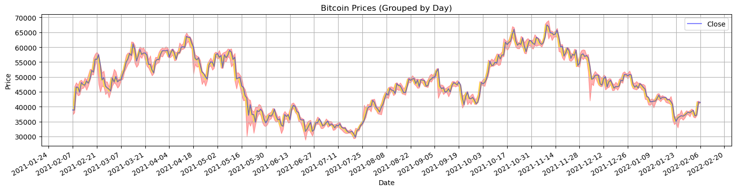
Dataset Characteristics
Bitcoin price
collected from the Binance API, with price data captured at one-minute intervals – Size: 3’126’000 rows x 10 columns – Timespan: 17. Aug 2017 till 01. Aug 2023
– Columns: [timestamp, open, high, low, close, volume, quote_asset_volume, number_of_trades, taker_buy_base_asset_volume, taker_buy_quote_asset_volume]

Slide 9
Preprocessing of data
Cleansing of data:
Reading data into pandas dataframe
Scan through the columns [data, user_name, user_followers, user_friends, user_favourites, text] and [timestamp, open, high, low, close, volume]
Identify Missing Values represented as
NaN, NA, NULL, or simply blank cells
Handle Duplicates
Identify and remove any duplicate rows from the dataset.
Correct Data Types
Ensure that each column has the correct data type
Adapt the timeline of Bitcoin prices to Bitcoin tweets:
Drop all other entries

Slide 10
Method Overview
Feature engineering (Sentiment Analysis)
Sentiments
Emotions
Irony
Correlation analysis
Short term
Long term
Prediction with LSTM

Slide 11

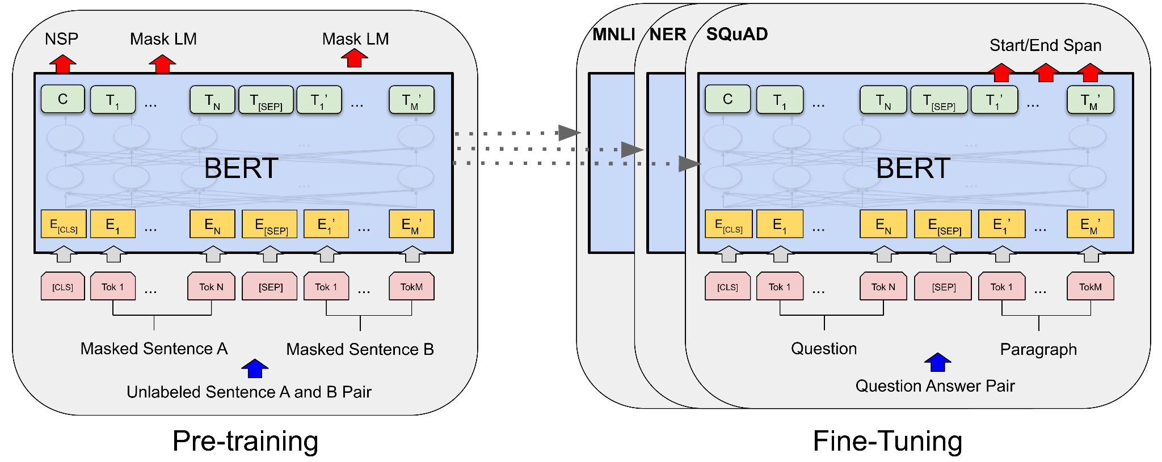
Model Architecture
Sentiment
cardiffnlp/twitter-roberta-base-sentiment
Emotion
cardiffnlp/twitter-roberta-base-emotion-multilabel-latest
RoBERTa
BERT
Transformer
Irony
cardiffnlp/twitter-roberta-base-irony
J. Camacho-Collados et al. "Tweetnlp: Cutting-edge natural language processing for social media." (2022).

Slide 12
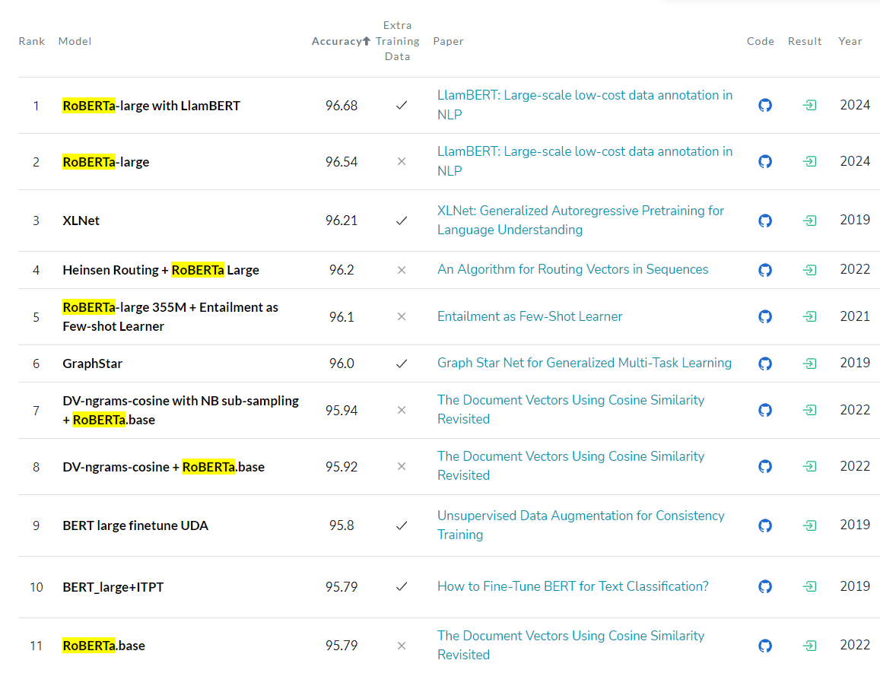
Sentiment Analysis on IMDb dataset
https://paperswithcode.com/sota/sentiment-analysis-on-imdb

Slide 13
Model Architecture
Sentiment
cardiffnlp/twitter-roberta-base-sentiment
trained on ~58M tweets
fine tuned on specific tasks (sentiment analysis, emotion classification, irony detection) using the TweetEval benchmark
Emotion
cardiffnlp/twitter-roberta-base-emotion-multilabel-latest
RoBERTa
Irony
cardiffnlp/twitter-roberta-base-irony
F. Barbieri et al. “TWEETEVAL: Unified Benchmark and Comparative Evaluation for Tweet Classification.” (2020).
J. Camacho-Collados et al. "Tweetnlp: Cutting-edge natural language processing for social media." (2022).

Slide 14
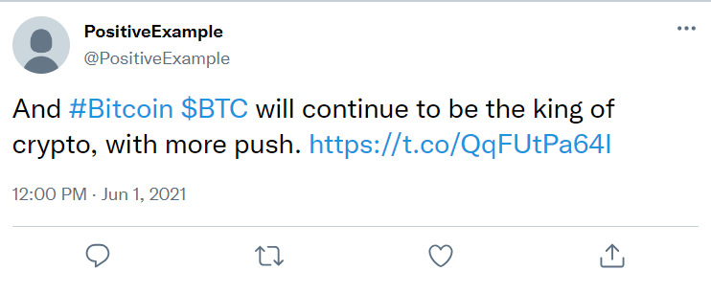
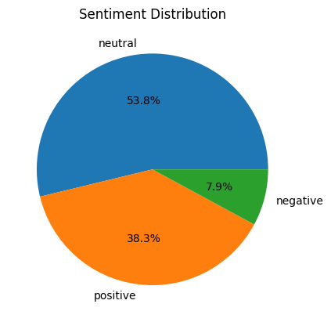
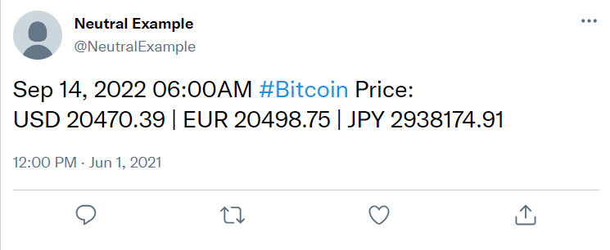
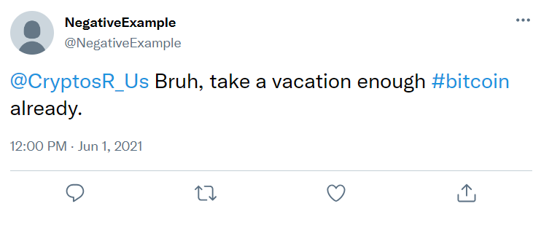
Sentiment

Slide 15
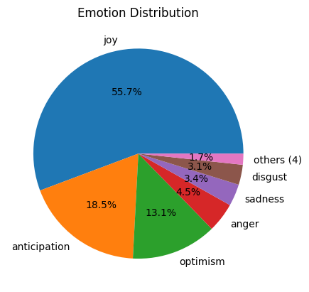
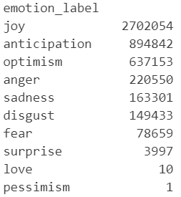
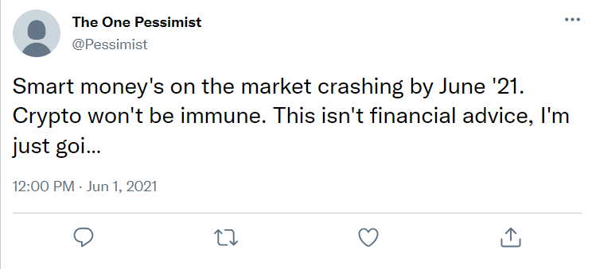
Emotion

Slide 16
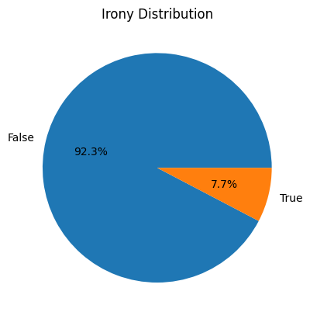
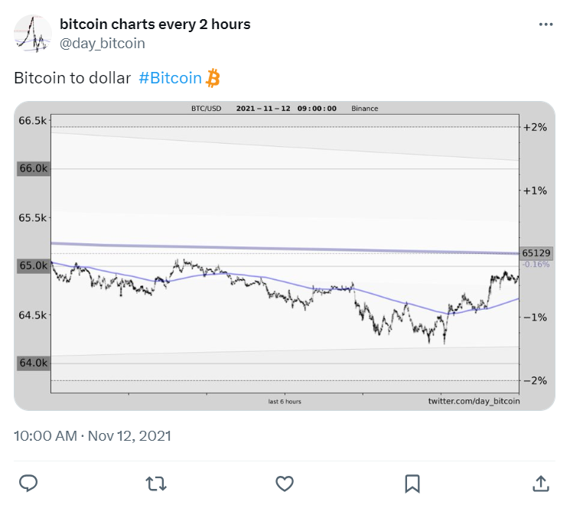
Irony
⛔ Model does not perform well.
Marked as irony

Slide 17

Sentimental Score
From the LLMs, we got 18 outputs.
['negative_prob', 'neutral_prob', 'positive_prob', 'irony_prob', 'anger_prob', 'anticipation_prob', 'disgust_prob', 'fear_prob', 'joy_prob', 'love_prob', 'optimism_prob', 'pessimism_prob', 'sadness_prob', 'surprise_prob', 'trust_prob', 'emotion_label', 'irony_label', 'sentiment_label’]
Formula to calculate the sentimental scores:

Slide 18

Combined Scores
From the original tweets data, we got:
['user_name', 'user_location', 'user_description', 'user_created', 'user_followers', 'user_friends', 'user_favourites', 'user_verified', 'date', 'text', 'hashtags', 'source', 'is_retweet’]
Final formula to calculate the combined score (used for prediction):
Choose the average close price as the Bitcoin price.
Average:
['user_followers', 'user_friends', 'user_favourites', 'is_retweet', 'negative_prob', 'neutral_prob', 'positive_prob', 'score’].

Slide 19
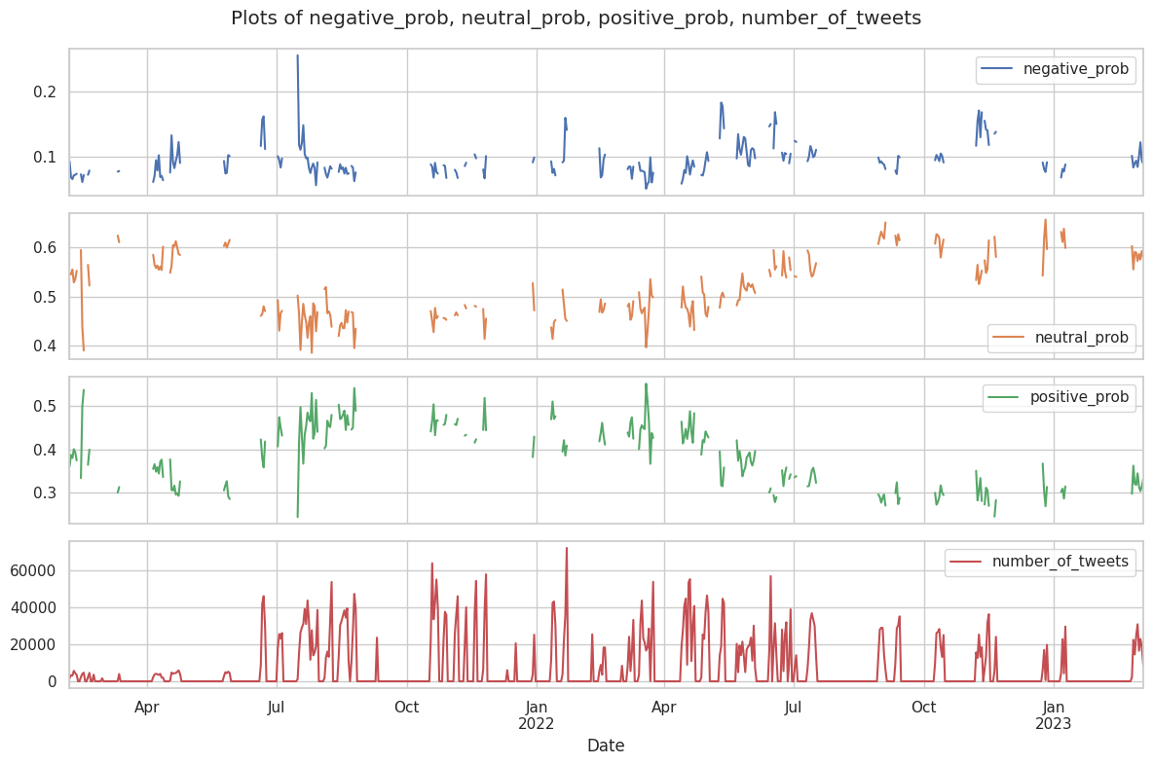
Sentiment Distribution Over Time

Slide 20
Two Correlations
Long Term Correlation:
1. Entire daily dataset from 2021/2/6 - 2023/3/5 combined Bitcoin close price and sentiment labels.
2. Calculate the lag cross correlation.
Short Term Correlation:
1. Longest consecutive non zero hourly tweets dataset from 2021/2/6 - 2023/3/5. (358 hours from 2021/7/16 - 2021/7/31)
2. Calculate which feature has the strongest correlation with bitcoin price.
3. Calculate the lag cross correlation.

Slide 21
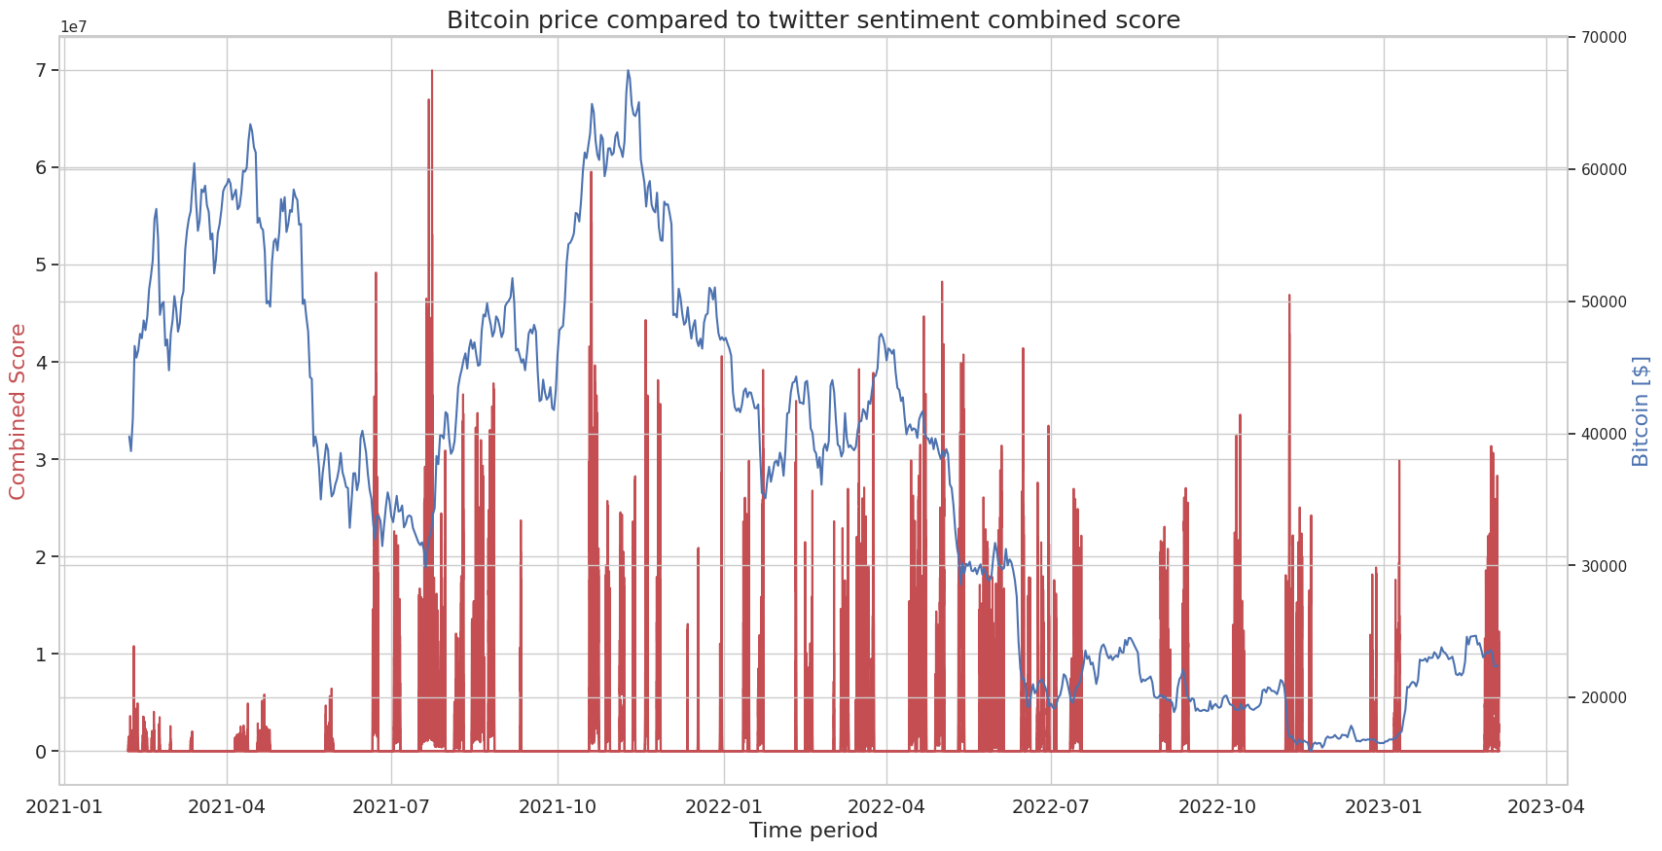
Correlation Analysis

Slide 22
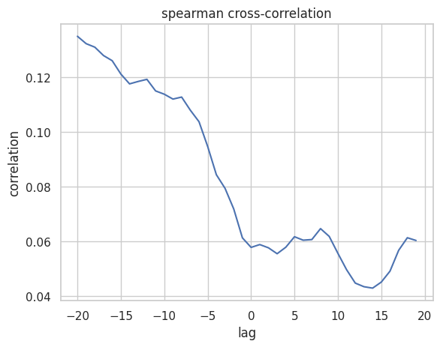
Long Term Correlations
Positive Lag: A positive lag means that the Twitter sentiment is being shifted forward in time (Twitter sentiment influences Bitcoin price).
Negative Lag: A negative lag means that the Bitcoin price is being shifted forward (Bitcoin price influences Twitter sentiment).

Slide 23
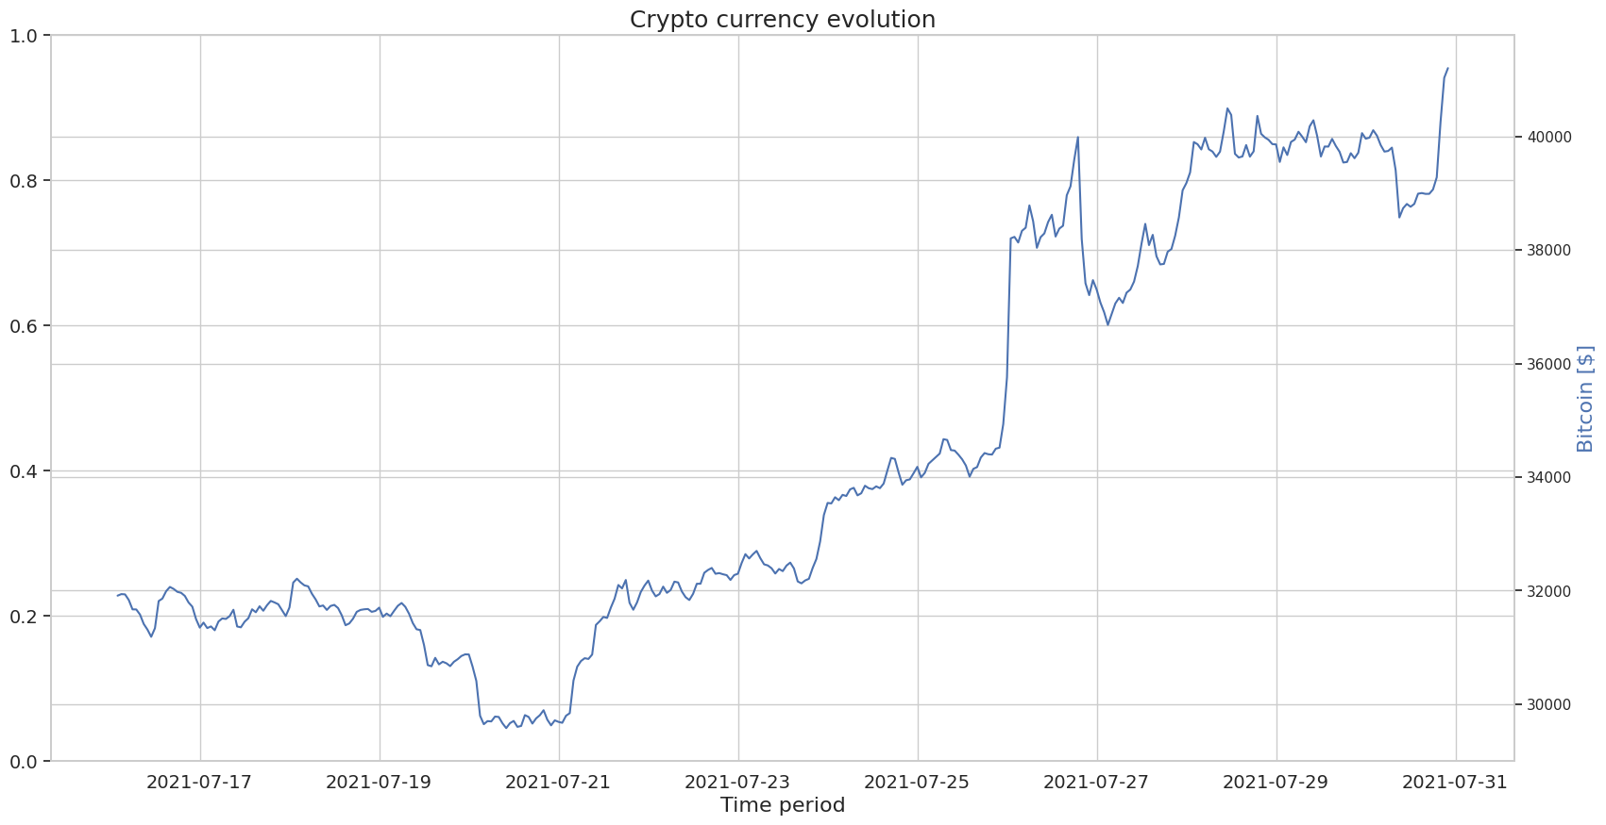
Short Term Correlations
Hourly data from 2021/7/16 - 2021/7/31

Slide 24
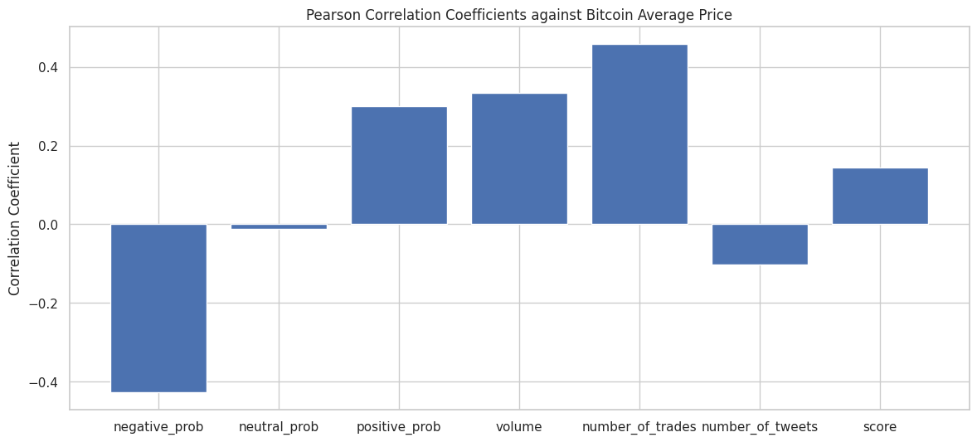
Short Term Correlations

Slide 25
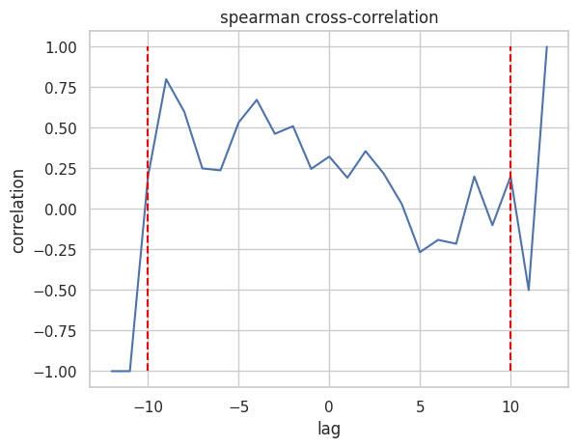
Short Term Correlations

Slide 26
Correlation Conclusion
Due to the non-continuous nature of our dataset, we decided to implement two correlations.
For long-term correlation:
1. Weak relationships between Twitter sentiment and Bitcoin prices.
2. The strongest relationships are indicated at negative lags.
For short-term correlation:
1. The negative probability indicates the strongest negative correlation and the number of trades indicates the strongest positive correlation.
2. Higher correlation for negative lags, suggesting that Twitter sentiment is more of a reaction to Bitcoin prices than a predictor.

Slide 27
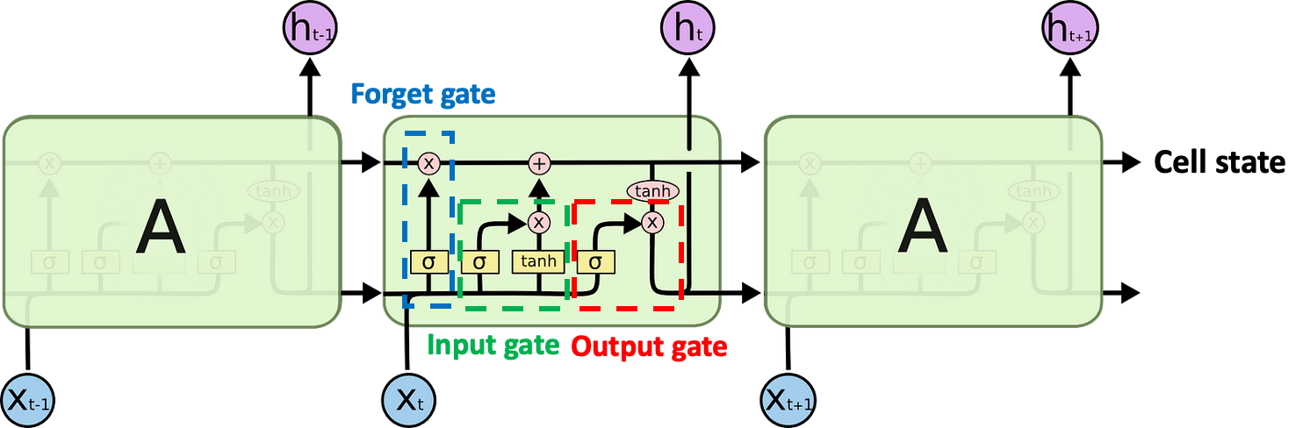
LSTM Model
Long Short-Term Memory (LSTM) networks are a type of Recurrent neural network (RNN) specialized in learning from sequences and retaining information over long periods.
Widely used for language translation, speech recognition, and time-series forecasting.
Notes:
Cell State: Stores the value from the previous neuron.
Input Gate: Determines whether to pass the neuron's input forward.
Forget Gate: Decides whether to retain or discard information from the cell state.
Output Gate: Decides whether the current output should be passed on.

Slide 28
Data for LSTM model
Market data per day
close, low, high, open, volume
Technical Indicators
MA7, MA20, MACD, 20SD, upper_band, lower_band, EMA, log(momentum)
Weighted average of sentimental score
weighted_positive_prob, weighted_negative_prob, weighted_neutral_prob
Preprocess: Use MinMaxScaler to scale each data column to range (0,1)
Create data chunks for LSTM to include data from the previous 10 days
Split training sample and test sample
First 90% of data: training sample
Last 10%: test sample
Notes:
MA7: 7-day Moving Average, indicating the average closing price over the last 7 days. (smoothing function talked in the course)
MA20: 20-day Moving Average, often used to assess price trends.
MACD: Moving Average Convergence Divergence, a trend-following momentum indicator.
20SD: 20-day Standard Deviation, measuring the price volatility.
Bollinger Bands (Upper band, Lower band): A set of trend indicators derived from the 20SD and moving averages.
EMA: Exponential Moving Average, giving more weight to recent prices.
Log(momentum): The logarithm of the momentum indicator, which measures the rate of price change.

Slide 29
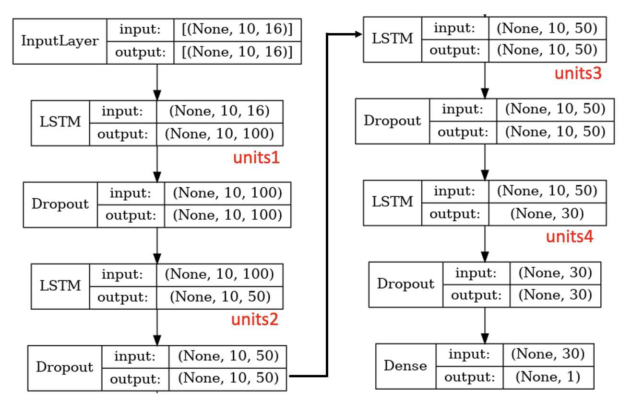
Our ML model
Optimizer: adam
Loss: mean squared error
y: close
Epochs: 100
Batch sizes: 32
Validation split = 0.2
Hyperparameter tuning
'units1': [100,200]
'units2': [50,80]
'units3': [30,50]
'units4’: [20,30]
Notes:
Dropout: prevent overfitting

Slide 30
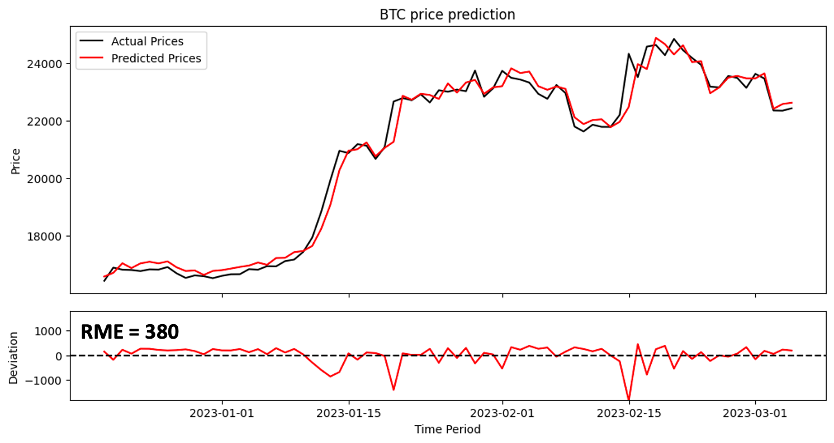
Prediction result with sentiment

Slide 31
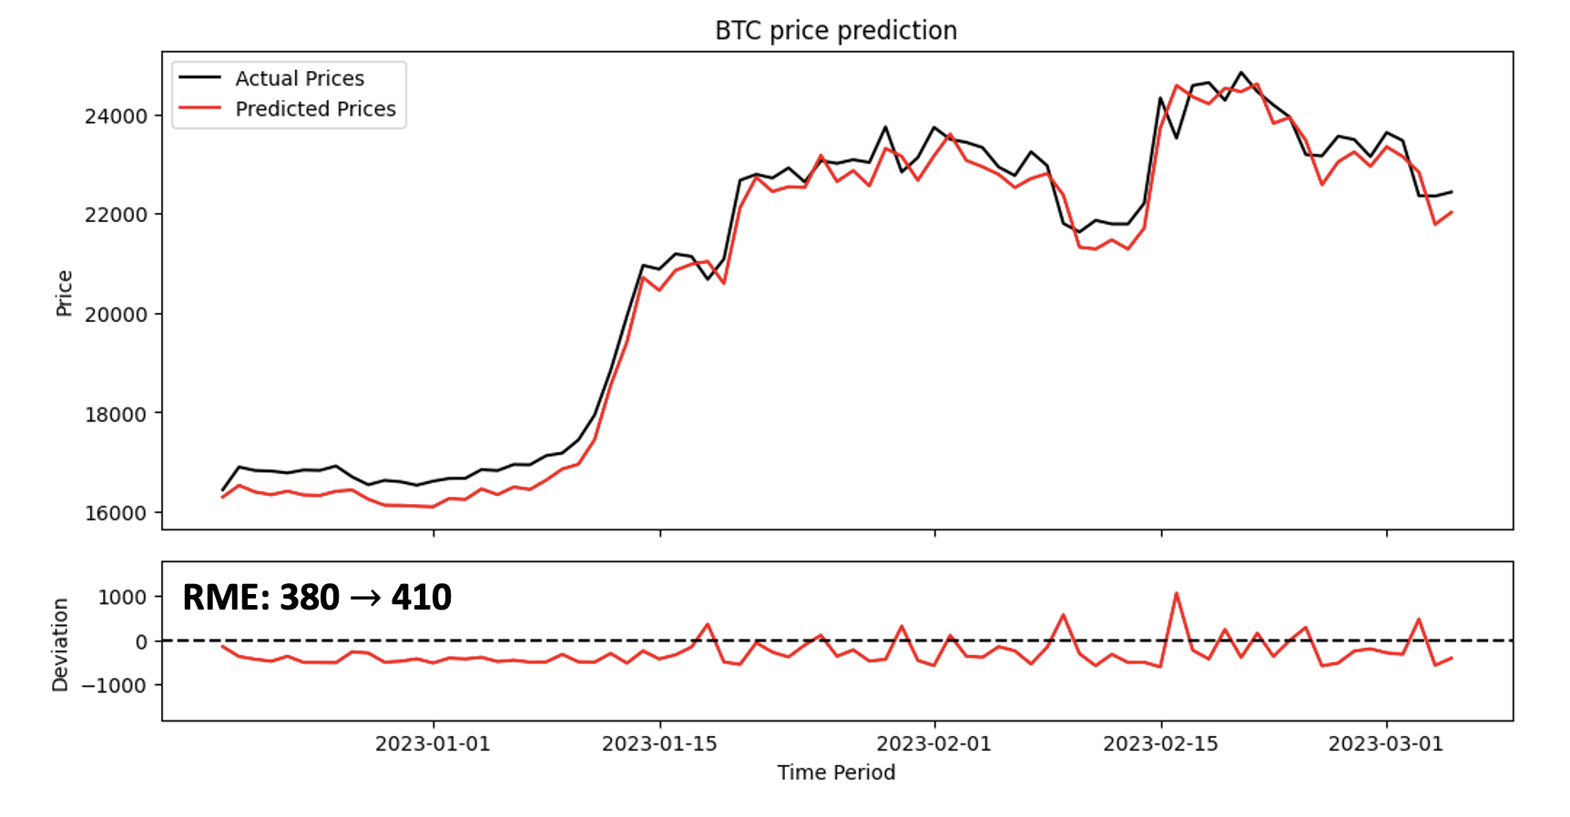
Prediction result without sentiment
Notes:
Sentiment is useful for predict the price

Slide 32
Conclusion
We have successfully integrated a range of data inputs, including daily market statistics, technical indicators, and weighted sentiment scores, into an LSTM framework tailored for financial forecasting.
The model exhibits a Root Mean Error (RME) of 380. It can provide accurate predictions of daily Bitcoin prices.
Although the correlation between sentiment and Bitcoin price is weak, sentiment analysis has positively influenced the model's prediction ability, suggesting its potential as a valuable feature in price-prediction models.

Slide 33
Future Work
Better sentiment (e.g. irony sucks, lack of awareness of topic)
Make prediction more explainable
Try different ML model for prediction. e.g. GRU
Input more aspects of data for training the model

Slide 34
Reference
F. Barbieri et al. “TWEETEVAL: Unified Benchmark and Comparative Evaluation for Tweet Classification.” (2020).
J. Camacho-Collados et al. "Tweetnlp: Cutting-edge natural language processing for social media." (2022).
https://huggingface.co/cardiffnlp/twitter-roberta-base-sentiment
https://huggingface.co/cardiffnlp/twitter-roberta-base-emotion-multilabel-latest
https://huggingface.co/cardiffnlp/twitter-roberta-base-irony
https://paperswithcode.com/sota/sentiment-analysis-on-imdb
https://www.kaggle.com/code/yadunandanbhat/bitcoin-price-analysis-by-tweets
https://www.kaggle.com/code/equinxx/stock-prediction-gan-twitter-sentiment-analysis
https://www.statista.com/statistics/1269669/bitcoin-dominance-historical-development/
https://de.statista.com/statistik/daten/studie/318483/umfrage/twitter-nutzerzahlen-weltweit-prognose/

Slide 35
Questions

